Slide 1
Linked List, Stack, and Queue
Il-Chul Moon Dept. of Industrial and Systems Engineering KAIST
icmoon@kaist.ac.kr

Slide 2
Weekly Objectives
This week, we learn the first set of data structures: linked list, stack, and queue.
Objectives are
Understanding the definition of abstract data types
Firmly understanding how references work
Understanding various linked list, stack, and queue structures
Singly linked list, doubly linked list, circular linked list…
Able to implement a stack and a queue with a list
Understanding the procedures of linked list, stack, and queue management
Insert, delete, search…
Should be able to estimate the number of steps for inserts, deletes, and searches

Slide 3
Array for List

Slide 4



Scenario for List
You are looking for Koh in the mass public
You are going to ask one by one “Are you Ms. Koh?”
Sometimes, you ask the question to a person multiple times
You realize that this is not going to work!
So, you line up the people and again ask the question one-by-one
You are looking for a restroom on the floor
The floor has a long corridor, and every room has an entrance to the corridor
You only need to follow the corridor
You have a dump of information of customers
How to store, search, and manipulate the information
You line them up as a list!

Slide 5
Abstract Data Types
An abstract data type (ADT) is an abstraction of a data structure
An ADT specifies:
Data stored
Operations on the data
Error conditions associated with operations
Example: ADT modeling a simple stock trading system
The data stored are buy/sell orders
The operations supported are
order buy(stock, shares, price)
order sell(stock, shares, price)
void cancel(order)
Error conditions:
Buy/sell a nonexistent stock
Cancel a nonexistent order
Operations
Data Stored

Slide 6
Creating a List by Array
Array (in our Python example, List, yet we will use only its index function)
Each element is accessible by index
Index is typically zero or a positive integer
Very simple creation
That’s why people use it
x[0]
x[1]
x[2]
x[3]
x[4]
‘a’
‘b’
‘d’
‘e’
‘f’

Slide 7
Search procedure in array
Let’s find ‘d’ and ‘c’ from the list in an array
Of course, you can use ‘in’, but we commit ourselves to use indexes only
Then, navigating from the first to the last until hit is the only way
x[0] == ‘c’ → False: No hit!
x[1] == ‘c’ → False: No hit!
x[2] == ‘c’ → False: No hit!
x[3] == ‘c’ → False: No hit!
x[4] == ‘c’ → False: No hit!
x[0]
x[1]
x[2]
x[3]
x[4]
After five retrievals,
we found that there will be no hit! (always N retrievals)
‘a’
‘b’
‘d’
‘e’
‘f’
After three retrievals,
we found the hit! (maximum N retrievals)
x[0] == ‘d’ → False: No hit!
x[1] == ‘d’ → False: No hit!
x[2] == ‘d’ → True: Hit!

Slide 8
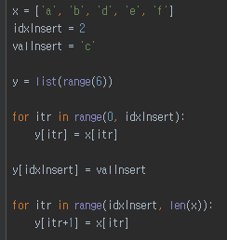
Insert procedure in array
Let’s insert ‘c’ between ‘b’ and ‘d’ in the list ( a = insert position index )
First, make new list, or y, with six cells
Second, copy the reference links of x[0:a-1] to y[0:a-1] (retrieval cnt.: a)
Third, put a reference link to ‘c’ in y[a] (retrieval cnt.: 1)
Fourth, copy the reference links of x[a:] to y[a+1:] (retrieval cnt.: n-a-1)
Fifth, change x’s reference to y’s reference
Total count of retrievals = a + 1 + n – a – 1 = n
x[0]
x[1]
x[2]
x[3]
x[4]
‘a’
‘b’
‘c’
‘d’
‘e’
‘f’
y[0]
y[1]
y[2]
y[3]
y[4]
y[5]

Slide 9
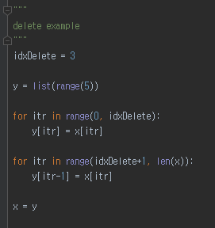
Delete procedure in array
Let’s remove ‘d’ in the list ( a = delete position index )
First, make new list, or y, with five cells
Second, copy the reference links of x[0:a-1] to y[0:a-1] (retrieval cnt.: a)
Third, copy the reference links of x[a+1:] to y[a:] (retrieval cnt.: n-a-1)
Fifth, change x’s reference to y’s reference
Total count of retrievals = a + n – a – 1 = n - 1
x[0]
x[1]
x[2]
x[3]
x[4]
x[5]
‘a’
‘b’
‘c’
‘d’
‘e’
‘f’
y[0]
y[1]
y[2]
y[3]
y[4]

Slide 10

Problems in Array
Whenever you put something in or get something out
You have to perform line-wise retrievals
Which is N retrievals (by assuming 100,000 – 1 ≒100,000)
This process is just like that
There is a line of airline passengers
You want to put a passenger in the middle of the line because his flight is about to leave
You are moving all the passengers one step back
Then, you put the customer in the line
What-if we have a magic to create a space in the middle of the line?
Array → you are bounded to the 1-dimension that you have
Linked list → you are bounded no more!
From Harry Porter

Slide 11
Linked List

Slide 12
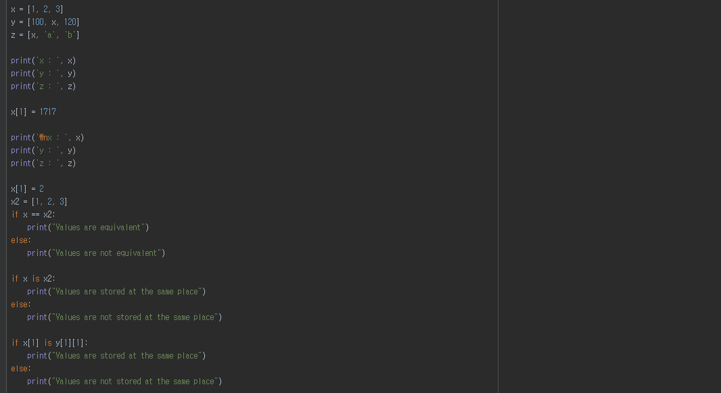
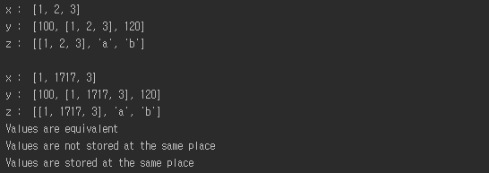
Detour: Assignment and Equivalence
y
y
1
x
3
reference
x
1
2
3
reference
One variable’s value is changed
But, you see three changes
Why this happened?
Because of references
x has two references from y and z
The values of y and z are determined by x, and x is changed
See the ripple effects
==
Checks the equivalence of two referenced values
is
Checks the equivalence of two referenced objects’ IDs
z
x
a
b

Slide 13
Basic Structure: Singly linked list
Construct a singly linked list with nodes and references
A node consists of
A variable to hold a reference to its next node
A variable to hold a reference to its value object
Special nodes: Head and Tail
You can construct the singly linked list without them
But, using them makes search, insert and delete more convenient
Generally, requires more coding than array
Object
N e x t
Object
N e x t
Object
N e x t
Object
N e x t
Head
Tail
‘a’
‘b’

Slide 14
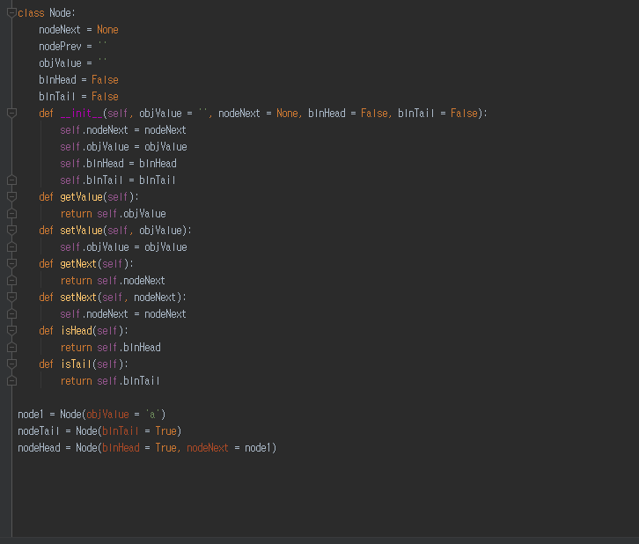
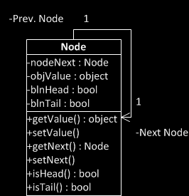
Implementation of Node class
Member variables
Variable to reference the next node
Variable to hold a value object
(Optional) Variable to check whether it is a head or not
(Optional) Variable to check whether it is a tail or not
Member functions
Various set/get methods

Slide 15
Head and Tail
Specialized node
Head : Always at the first of the list
Tail : Always at the last of the list
These are the two corner stone showing the start and the end of the list
These are optional nodes.
Linked list works okay without these
However, having these makes implementation very convenient
Any example?
Empty Linked List
Object
N e x t
Object
N e x t
Head
Tail
Linked List with Two Nodes
Object
N e x t
Object
N e x t
Object
N e x t
Object
N e x t
Head
Tail
‘a’
‘b’

Slide 16
Search procedure in singly linked list
Again, let’s find ‘d’ and ‘c’ from the list
Just like an array, navigating from the first to the last until hit is the only way
No difference in the search pattern, though you cannot use index any further!
Your list implementation may include the index function, but it is not required in the linked list
node.objValue == ‘c’ → False: No hit!
node.objValue == ‘c’ → False: No hit!
node.objValue == ‘c’ → False: No hit!
node.objValue == ‘c’ → False: No hit!
node.objValue == ‘c’ → False: No hit!
head
‘a’
‘b’
‘d’
‘e’
‘f’
tail
node.objValue == ‘d’ → False: No hit!
node.objValue == ‘d’ → False: No hit!
node.objValue == ‘d’ → True: Hit!
After five retrievals,
we found that there will be no hit! (always N retrievals)
After three retrievals,
we found the hit! (maximum N retrievals)

Slide 17
Insert procedure in singly linked list
This is the moment that you see the power of a linked list
Last time, you need N retrievals to insert a value in the array list
This time, you need only three operations
With an assumption that you have a reference to the node, Node_{prev} that you want to put your new node next
First, you store a Node, or a Node_{next}, pointed by a reference from Node_{prev}’s nodeNext member variable
Second, you change a reference from Node_{prev}’s nodeNext to Node_{new}
Third, you change a reference from Node_{new}’s nodeNext to Node_{next}
Node_{new}
(3) Add this reference
(2) Update this reference
‘c’
(1) Store this node
head
‘a’
‘b’
‘d’
‘e’
‘f’
tail
Node_{prev}
Node_{next}
Over-written with a new reference to the new node

Slide 18
Delete procedure in singly linked list
This is the another moment that you see the power of a linked list
Last time, you need N retrievals to delete a value in the array list
This time, you need only three operations
With an assumption that you have a reference to the node, Node_{prev} that you want to remove the node next
First, you retrieve Node_{next} that is two steps next from Node_{prev}
Second, you change a reference from Node_{prev}’s nodeNext to Node_{next}
The node will be removed because there is no reference to Node_{remove}
(2) Update this reference
(1) Retrieve this node that is two step next
head
‘a’
‘b’
‘c’
‘d’
‘e’
‘f’
tail
Node_{prev}
Node_{remove}
Node_{next}
Over-written with a new reference to the next node of the removed one

Slide 19
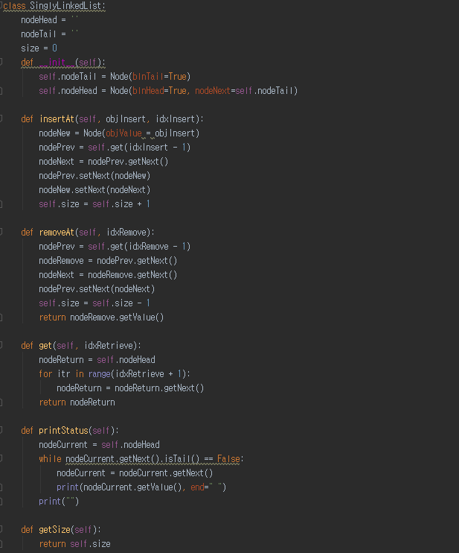
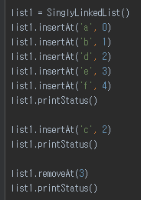

Implementation of Singly linked list
Empty Linked List
Object
N e x t
Object
N e x t
Head
Tail

Slide 20
Stack and Queue

Slide 21







Scenario for Stack
Back seat of a taxi
One way in and out
We are traveling from the source to our destinations
Who should seat first and last?
A scenario for a taxi = A scenario for SCM
A cargo plane with one way in and out
How to organize the cargo loading to the plane?

Slide 22
Structure of Stack
Top Only Accessible
Stacks are linear like linked lists
A variation of a singly linked list
Difference
Voluntarily giving up
Access to the middle in the linked list
Only accesses to the first instance in the list
The first instance in the list
= The top instance in the stack
An item is inserted or removed from the stack from one end called the “top” of the stack.
This mechanism is called Last-In-First-Out (LIFO).
Cargo Object 1
Cargo Object 2
Cargo Object 3
Cargo Object 4
Cargo Object 5
Cargo Object 6

Slide 23





Operation of Stack
Stack operation
Push
= Insert an instance at the first in the linked list
= Put an instance at the top in the stack
Pop
= Remove and return an instance at the first in the linked list
= Remove and return an instance at the top in the stack
Push
Moon
Push
Shin
Push
Lee
Pop
Lee
Pop
Shin
Pop
Moon

Slide 24
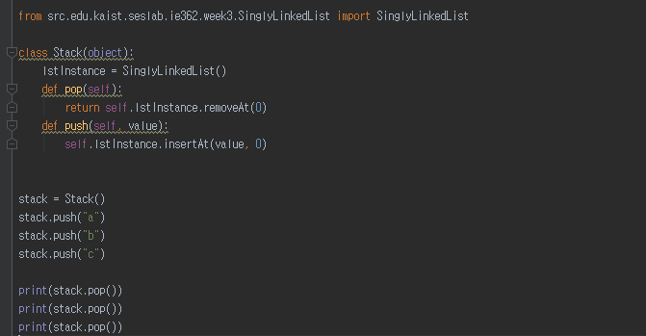

Implementation of Stack
Python code of a stack
Utilizing a singly linked list
To pop an instance
1 retrieval count
To push an instance
1 retrieval count

Slide 25
Example: Balancing Symbols
Balancing symbols?
[2+(1+2)]-3 → Symbols are balanced
[2+(1+2]-3 → Symbols are not balanced
Then, just counting opening and closing symbols?
What if? [2+(1]+2)-3
Algorithm for the balanced symbol checking
Make an empty stack
read symbols until end of formula
if the symbol is an opening symbol push it onto the stack
if it is a closing symbol do the following
If the stack is empty report an error
Otherwise pop the stack.
If the symbol popped does not match the closing symbol report an error
At the end of the of formula if the stack is not empty report an error
7+{[2+(1+2)]*3}
(
[
[
{
{
{
[
{
{

Slide 26

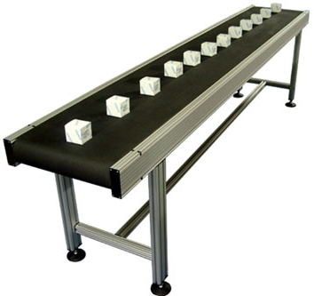
Scenario for Queue
Line at an airport
A way for going in
At the end of the line
Another way for going out
At the first of the line
No one gets in the middle of the line
A scenario of a line at the airport = A scenario of a production line at a factory
The first product out is the first product in
How to track the production line?

Slide 27
Structure of Queue
Queues are linear like linked lists
A variation of a singly linked list
Difference
Voluntarily giving up
Access to the middle in the linked list == Same to the stacks
Only accesses to the first and the last instances in the list
The first instance in the list
= The front instance in the queue
The last instance in the list
= The rear instance in the queue
An item is inserted at the last
An item is removed at the front
This mechanism is called First-In-First-Out (FIFO)
Product 1
Product 2
Product 3
Product 4

Slide 28


Operation of Queue
Enqueue Lee
Queue operation
Enqueue
= Insert an instance at the last in the linked list
= Put an instance at the rear in the queue
Dequeue
= Remove and return an instance at the first in the linked list
= Remove and return an instance at the front in the queue
Enqueue Shin
Enqueue Moon
Dequeue Lee
Dequeue Shin
Dequeue Moon

Slide 29
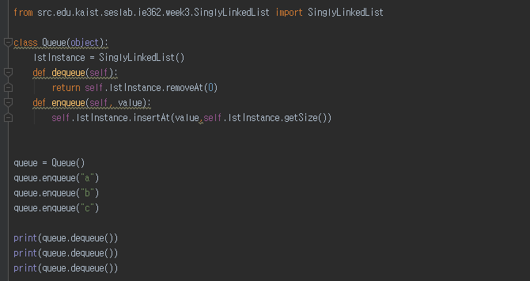

Implementation of Queue
Python code of a queue
Utilizing a singly linked list
To enqueue an instance
1 retrieval count
To dequeue an instance
1 retrieval count

